Slide 1

CSCI/ARTI 8950 Machine Learning
Lecture Notes 5: Geometry, Nearest Neighbor & Performance Measures
Khaled Rasheed
Professor
School of Computing
Member
Institute for Artificial Intelligence
University of Georgia
Credit: some examples & figures by Marine Carpuat, Tom Mitchell & CIML

Slide 2
What we know so far
Decision Trees
What is a decision tree, and how to induce it from data
Fundamental Machine Learning Concepts
Difference between memorization and generalization
What inductive bias is, and what is its role in learning
What underfitting and overfitting means
How to take a task and cast it as a learning problem
Why you should never ever touch your test data!!

Slide 3
New Topics
Nearest Neighbors (NN) algorithms for classification
K-NN, Epsilon ball NN
Fundamental Machine Learning Concepts
Decision boundary

Slide 4
Intuition for Nearest Neighbor Classification
This “rule of nearest neighbor” has considerable elementary intuitive appeal and probably corresponds to practice in many situations. For example, it is possible that much medical diagnosis is influenced by the doctor’s recollection of the subsequent history of an earlier patient whose symptoms resemble in some way those of the current patient.
(Fix and Hodges, 1952)

Slide 5
Intuition for Nearest Neighbor Classification
Simple idea
Store all training examples
Classify new examples based on most similar training examples

Slide 6
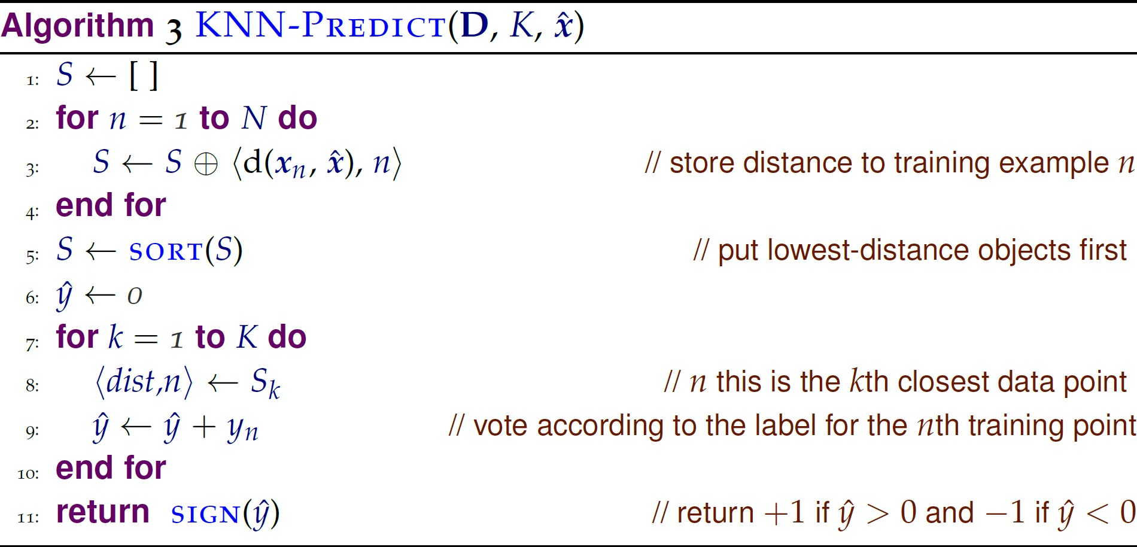
K Nearest Neighbor Classification
K: number of neighbors that
classification is
based on Test instance with
unknown class in
{ −1; +1 }
Training Data

Slide 7
2 approaches to learning
Eager learning
(eg decision trees)
Learn/Train
Induce an abstract model
from data
Test/Predict/Classify
Apply learned model to new data
Lazy learning
(eg nearest neighbors)
Learn
Just store data in memory
Test/Predict/Classify
Compare new data to stored data
Properties
Retains all information seen in training
Complex hypothesis space
Classification can be very slow

Slide 8
Components of a k-NN Classifier
Distance metric
How do we measure distance between instances?
Determines the layout of the example space
The k hyperparameter
How large a neighborhood should we consider?
Determines the complexity of the hypothesis space

Slide 9
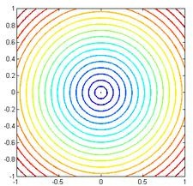
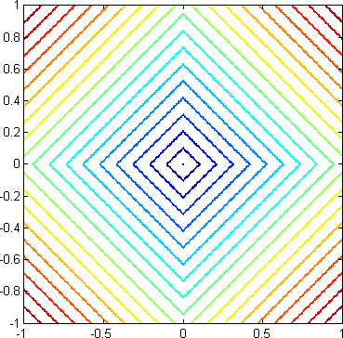
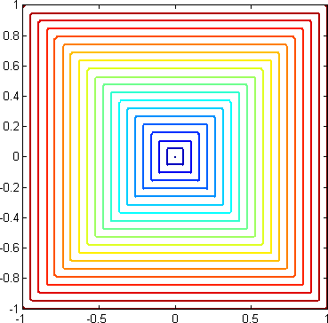
Distance metrics
We can use any distance function to select nearest neighbors.
Different distances yield different neighborhoods
L2 distance
( = Euclidean distance)
L1 distance
Max norm

Slide 10
Decision Boundary of a Classifier
It is the line that separates positive and negative regions in the feature space
Why is it useful?
it helps us visualize how examples will be classified for the entire feature space
it helps us visualize the complexity of the learned model

Slide 11
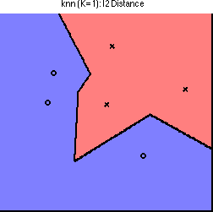
Decision Boundaries for 1-NN

Slide 12
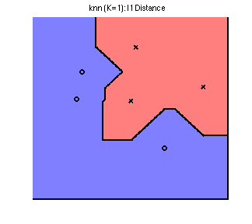
Decision Boundaries change with the distance function

Slide 13
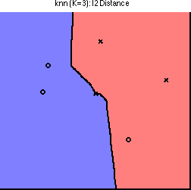
Decision Boundaries change
with K

Slide 14
The k hyperparameter
Tunes the complexity of the hypothesis space
If k = 1, every training example has its own neighborhood
If k = N, the entire data set is one neighborhood!
Higher k yields smoother decision boundaries
How would you set k in practice?

Slide 15
What is the inductive bias of
k-NN?
Nearby instances should have the same label
All features are equally important
Complexity is tuned by the k parameter

Slide 16
Variations on k-NN: Weighted voting
Weighted voting
Default: all neighbors have equal weight
Extension: weight neighbors by (inverse) distance

Slide 17
Variations on k-NN: Epsilon Ball Nearest Neighbors
Same general principle as K-NN, but change the method for selecting which training examples vote
Instead of using K nearest neighbors, use all examples y such that
𝑑𝑖𝑠𝑡𝑎𝑛𝑐𝑒 ( 𝑥 ,y) ≤𝜀

Slide 18
Exercise: How would you modify KNN- Predict to perform Epsilon Ball NN?

Slide 19
Recap
Nearest Neighbors (NN) algorithms for classification
K-NN, Epsilon ball NN
Take a geometric view of learning
Fundamental Machine Learning Concepts
Decision boundary
Visualizes predictions over entire feature space
Characterizes complexity of learned model
Indicates overfitting/underfitting

Slide 20
Performance measures
The confusion matrix:
Accuracy is ratio between the diagonal elements and the full matrix. I.e. Accuracy= TP + TN/ TP + FP + TN + FN
Can be extended to multi-class problems
Different misclassification costs can be assigned to false positives and false negatives
There are many other types of performance measures
Predicted class
Yes
No
Yes
True positive (TP)
False negative (FN)
Actual class
No
False positive (FP)
True negative (TN)
[Source: Data Mining by Witten, Frank, Hall and Pal]

Slide 21
More measures...
Fraction of relevant documents that are returned: recall = TP/(TP+FN)
Out of all positives, what proportion was correctly classified?
Fraction of retrieved documents that are relevant: precision= TP/(TP+FP)
Out of all classified positive, what proportion was actually positive?
In some domains Recall may be more important than accuracy (e.g. Medical diagnosis)
F-measure=(2 × recall × precision)/(recall + precision)
sensitivity × specificity = (TP / (TP + FN)) × (TN / (FP + TN))
Area under the ROC curve (AUC): probability that randomly chosen positive instance is ranked above randomly chosen negative one
[Source: Data Mining by Witten, Frank, Hall and Pal]

Slide 22
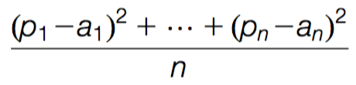
Evaluating numeric prediction
Same strategies: independent test set, cross-validation, significance tests, etc.
Difference: error measures
Actual target values: a₁ a₂ …a_{n}
Predicted target values: p₁ p₂ … p_{n}
Most popular measure: mean-squared error
Easy to manipulate mathematically
[Source: Data Mining by Witten, Frank, Hall and Pal]

Slide 23
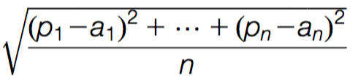

Other measures
The root mean-squared error :
The mean absolute error is less sensitive to outliers than the mean-squared error:
Sometimes relative error values are more appropriate (e.g. 10% for an error of 50 when predicting 500)
[Source: Data Mining by Witten, Frank, Hall and Pal]

Slide 24
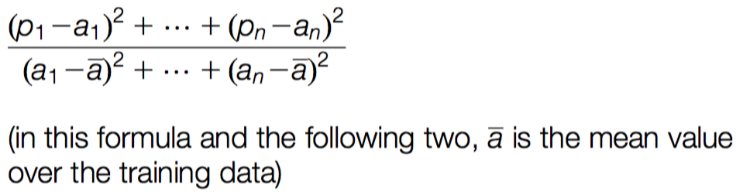
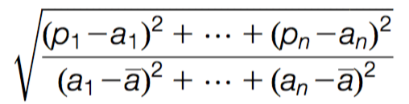
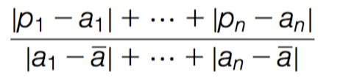
Improvement on the mean
How much does the scheme improve on simply predicting the average?
The relative squared error is:
The root relative squared error and the relative absolute error are:
[Source: Data Mining by Witten, Frank, Hall and Pal]

Slide 25
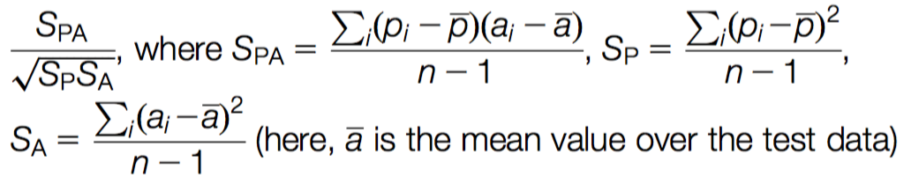
Correlation coefficient
Measures the statistical correlation between the predicted values and the actual values
Scale independent, between –1 and +1
Good performance leads to large values!
[Source: Data Mining by Witten, Frank, Hall and Pal]

Slide 26
Which measure?
Best to look at all of them
Often it doesn’t matter
Example:
A
B
C
D
Root mean-squared error
67.8
91.7
63.3
57.4
Mean absolute error
41.3
38.5
33.4
29.2
Root rel squared error
42.2%
57.2%
39.4%
35.8%
Relative absolute error
43.1%
40.1%
34.8%
30.4%
Correlation coefficient
0.88
0.88
0.89
0.91
D best
C second-best
A, B arguable
[Source: Data Mining by Witten, Frank, Hall and Pal]

